Slide 1
Clustering and Customer
Segmentation
Final Presentation • RFM Analysis with K-Means in Altair AI Studio
Team: Arshiya Ahmed · Ankit Sharma · Bahrom Homidov
Instructor: Prof. Salman Qureshi | Potomac University | Project 8
Clustering & Customer Segmentation — Final Presentation
1

Slide 2
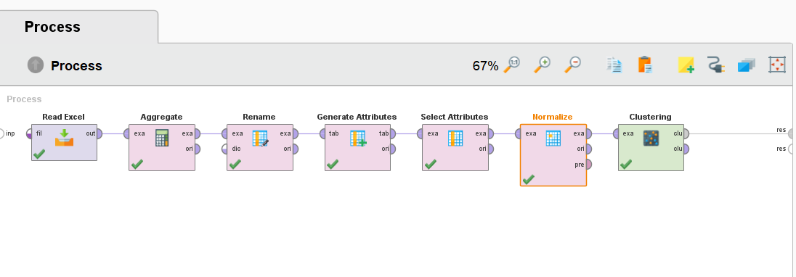
1. PROCESS
Final Clustering Workflow
The final pipeline in Altair AI Studio (RapidMiner) carries seven operators end to end — from raw transaction import through normalized, clustered output.
Read Excel → Aggregate → Rename → Generate Attributes → Select Attributes → Normalize → Clustering
Clustering & Customer Segmentation — Final Presentation
2

Slide 3
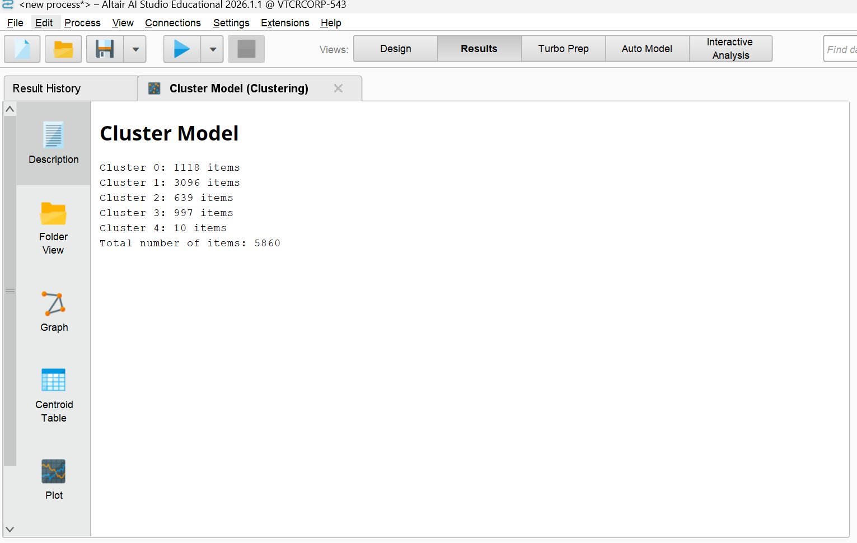
2. RESULTS
Final Cluster Solution
Cluster | Segment | Customers | % of Total
Cluster 1 | Loyal Customers | 3096 | 52.8%
Cluster 0 | Occasional Customers | 1118 | 19.1%
Cluster 3 | Regular Customers | 997 | 17.0%
Cluster 2 | Inactive Customers | 639 | 10.9%
Cluster 4 | VIP Customers | 10 | 0.2%
K-Means (K = 5) was applied to 5,860 customers built from cleaned Online Retail II transactions, using normalized Recency, Frequency, and Monetary variables.
Clustering & Customer Segmentation — Final Presentation
3

Slide 4
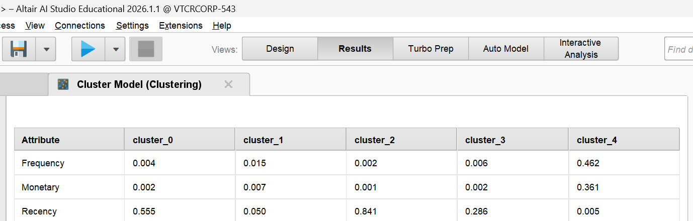
3. INTERPRETATION
Cluster Profiles
Segment | Recency | Frequency | Monetary | Size
VIP Customers | 0.005 | 0.462 | 0.361 | 10
Loyal Customers | 0.050 | 0.015 | 0.007 | 3096
Regular Customers | 0.286 | 0.006 | 0.002 | 997
Occasional Customers | 0.555 | 0.004 | 0.002 | 1118
Inactive Customers | 0.841 | 0.002 | 0.001 | 639
Clustering & Customer Segmentation — Final Presentation
4

Slide 5
4. VISUALIZATION
Visualization of Cluster Differences
Normalized RFM values by segment (0–1 scale)
What the chart shows
VIP stands apart on Frequency and Monetary — no other segment comes close
Loyal customers have the lowest Recency (most recent activity) outside VIP
Inactive customers have by far the highest Recency — longest time since last purchase
Regular and Occasional sit in between, differentiated mainly by Recency
Clustering & Customer Segmentation — Final Presentation
5

Slide 6
5. SCENARIO ANALYSIS
Scenario Analysis: Comparing Cluster Counts
K = 4
K = 5 (Selected)
Fewer, broader groups — easier to summarize but less precise
High-value customers get combined with mid-tier ones
VIP customers lose visibility inside a larger "good customer" bucket
Simpler to act on, but the highest-value segment can't be targeted precisely
VIP customers isolated as their own segment (10 customers, distinct centroid)
Loyal, Regular, Occasional, and Inactive separate cleanly along Recency
Every segment maps to a distinct, actionable marketing action
Best balance of interpretability and business relevance
K = 3 was too broad to be useful; K = 6 split off a very small, low-value cluster with little business meaning. K = 4 vs. K = 5 was the meaningful trade-off — isolating the VIP segment justified the extra cluster.
Clustering & Customer Segmentation — Final Presentation
6

Slide 7
6. RECOMMENDATIONS
Recommendation for Each Segment
VIP Customers
Priority retention: white-glove service, early access, exclusive rewards. Protect this 0.2% — they carry outsized revenue.
Loyal Customers
Formal loyalty program with tiered perks. This is the largest segment (52.8%) — small improvements in retention have the biggest revenue impact.
Regular Customers
Periodic promotions and cross-sell offers to nudge toward Loyal status.
Occasional Customers
Targeted re-engagement offers before recency slips further — a nudge now is cheaper than a win-back campaign later.
Inactive Customers
Win-back campaigns (discount codes, "we miss you" email); deprioritize spend on customers who don't respond after 1–2 attempts.
Clustering & Customer Segmentation — Final Presentation
7

Slide 8
7. VALUE
Business Value of Segmentation
Focus limited resources
Prevent revenue leakage
52.8% of customers (Loyal) plus 0.2% (VIP) drive disproportionate value — spend can concentrate where it pays off.
Occasional customers (19.1%) are still reachable before they slide into the Inactive segment (10.9%).
Personalize at scale
Measure what matters
Five clear segments replace one-size-fits-all campaigns with messaging matched to actual behavior.
RFM gives a repeatable, quantitative basis for tracking segment migration over time — not just a one-time label.
Clustering & Customer Segmentation — Final Presentation
8

Slide 9
8. CRITIQUE
Self-Critique: Are the Clusters Actionable?
What supports actionability
Remaining limitations
Each segment has a distinct centroid — not just arbitrary splits
Segments map directly to different marketing actions (Slide 7)
The VIP segment, though tiny, is real and high-value — worth isolating
K = 5 was chosen by comparing against K = 3, 4, and 6, not by default
No formal validity metric (Silhouette Score) computed yet to confirm K = 5 statistically
RFM alone doesn't explain why customers behave this way — no product or channel data
The VIP cluster (n = 10) is small enough that outliers could be shaping it disproportionately
Segments are a static snapshot — no tracking yet of movement between segments over time
Bottom line: the clusters are actionable now — each has a clear, distinct recommendation — but Silhouette validation and time-based tracking would strengthen confidence further.
Clustering & Customer Segmentation — Final Presentation
9

